Slide 1
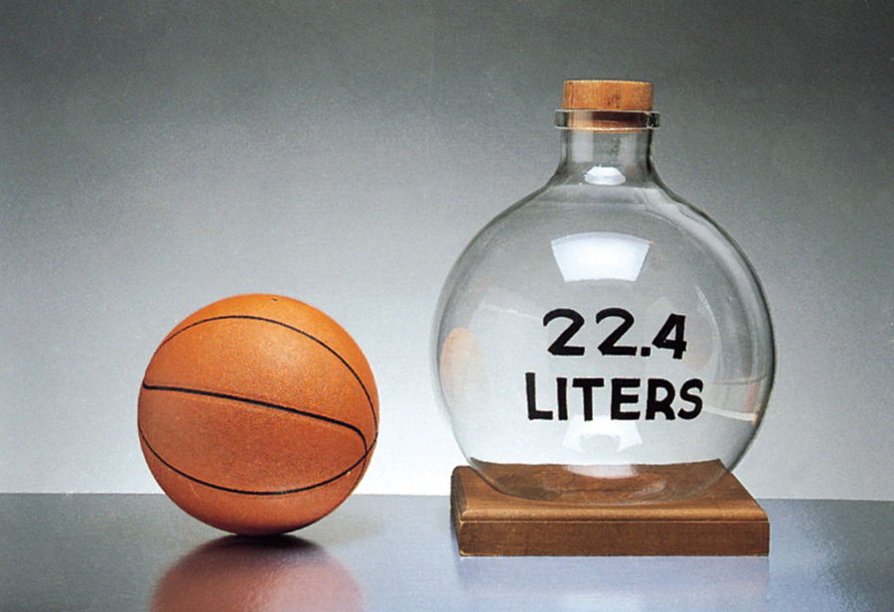
PV=nRT
STP: 0ºC and 1 atm
V for 1 mol gas at STP:
V = nRT/P
=1mol (0.08206 L·atm/K·mol) 273K/ 1atm
= 22.4 L

Slide 2
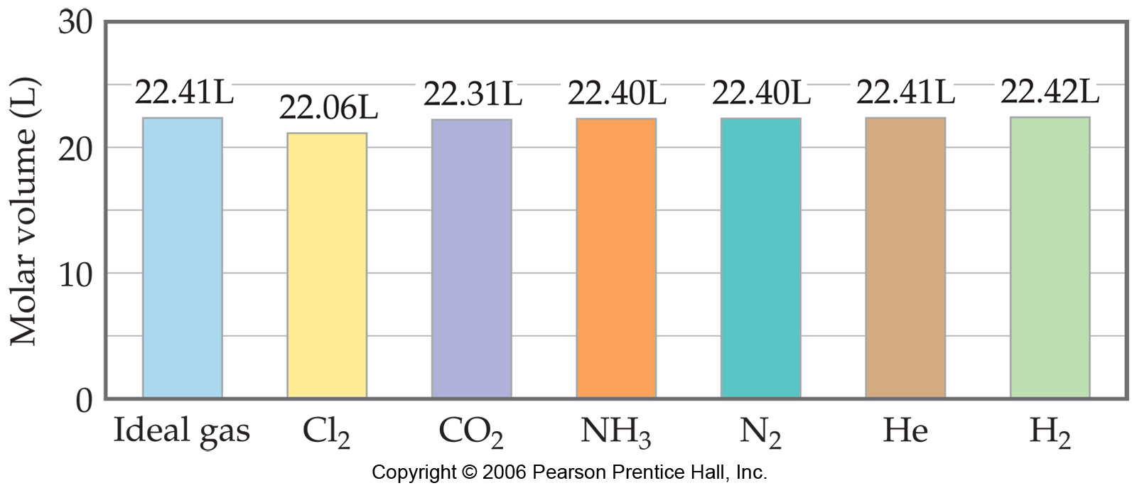
PV=nRT
STP: 0ºC and 1 atm
V for 1 mol gas at STP:
V = nRT/P
=1mol (0.08206 L·atm/K·mol) 273K/ 1atm
= 22.4 L

Slide 3
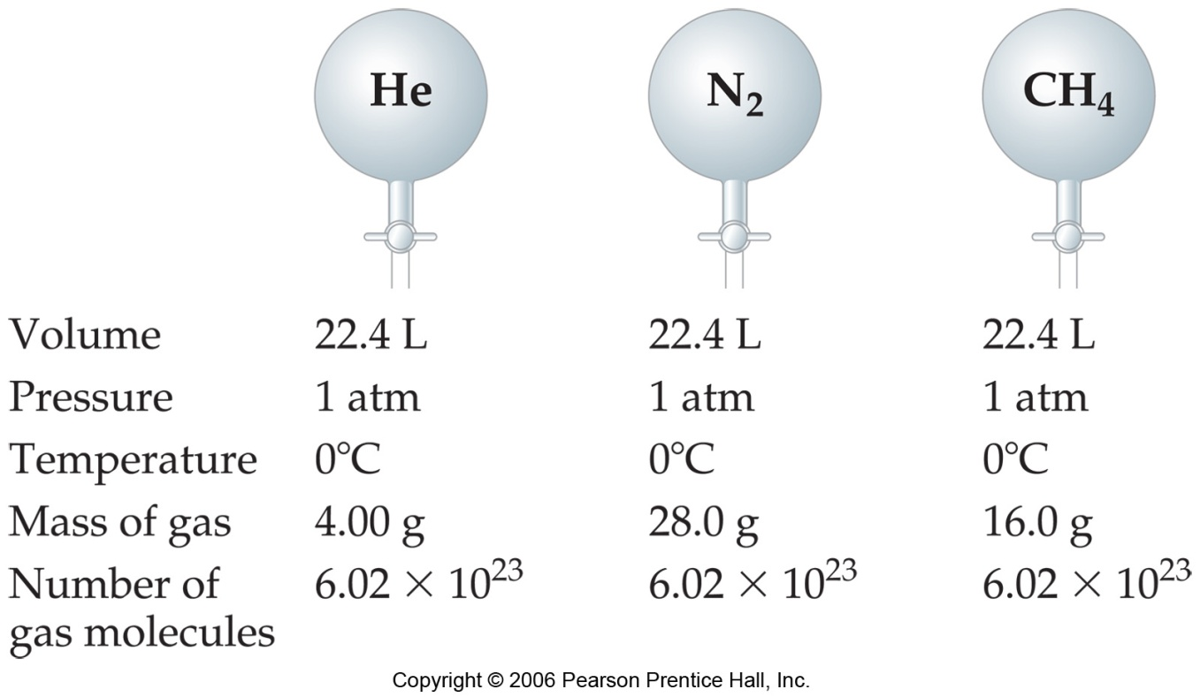
PV=nRT
STP: 0ºC and 1 atm
V for 1 mol gas at STP:
V = nRT/P
=1mol (0.08206 L·atm/K·mol) 273K/ 1atm
= 22.4 L

